Slide 1

Right here for
Labor-Management Healthcare Fund

Slide 2














Labor-Management Healthcare Fund Members
TERRACE VIEW
Notes:
Add the LMHF logo

Slide 3


Right Here for Labor-Management Healthcare Fund ​​
Your Success is Our Success
Match current benefit profiles for all plans​
Pre- and Post-implementation customer service​
  Onboarding 60 Days before effective date​
    Onsite meetings​
    Call or Email LMHF Concierge Team​
    LMHF Custom Webpage​
Custom LMHF welcome mailer to members
  Personalized welcome letter
  Info for how to contact Concierge Service Team

Slide 4
So how do we do it?
Our approach is built around three ideas:
1.
We Put People First
We give members more control and combine medical expertise and data to address health conditions on a more personal, proactive level.
We Make Service Simple
We make it easier for members to understand and use their benefits, and we help make claims and processing more efficient and transparent for employers.
We Take Our Network to Another Level
We bring you the area’s largest local network, so coverage is always there when your team needs it, where they need it.
2.
3.

Slide 5
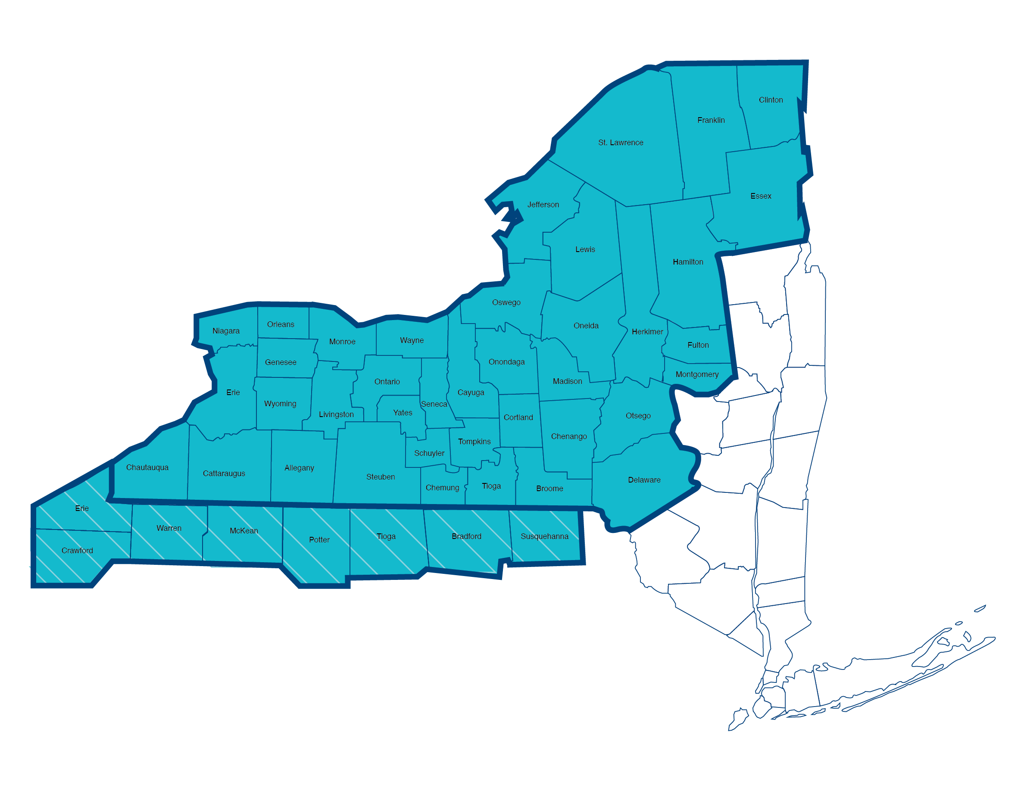


Largest Network in Upstate NY
Plus Peace of Mind With Nationwide Coverage
Right Here for the Labor-Management Healthcare Fund
Univera Healthcare PPO: 39 Upstate NY counties
>99% of providers and 100% of hospitals
and strategic physician groups
No fees for claims, no fees for network access with our direct contracts
>1.2 million practitioners and 5,600 hospitals
*NOT limited to only Quest Labs

Slide 6
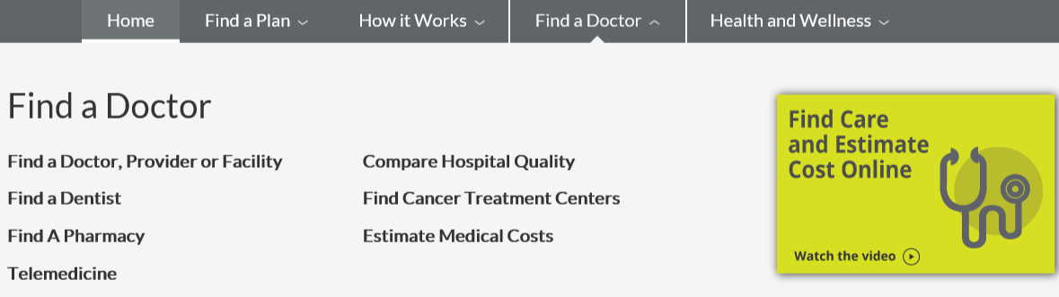

Find a Doctor using the Univera Website
IF not found:
Please contact us:
univeraPR@univerahealthcare.com
-Local
ConciergeTeam@univerahealthcare.com.
-Out of Area

Slide 7

Innovative Member Tools
& Reporting

Slide 8
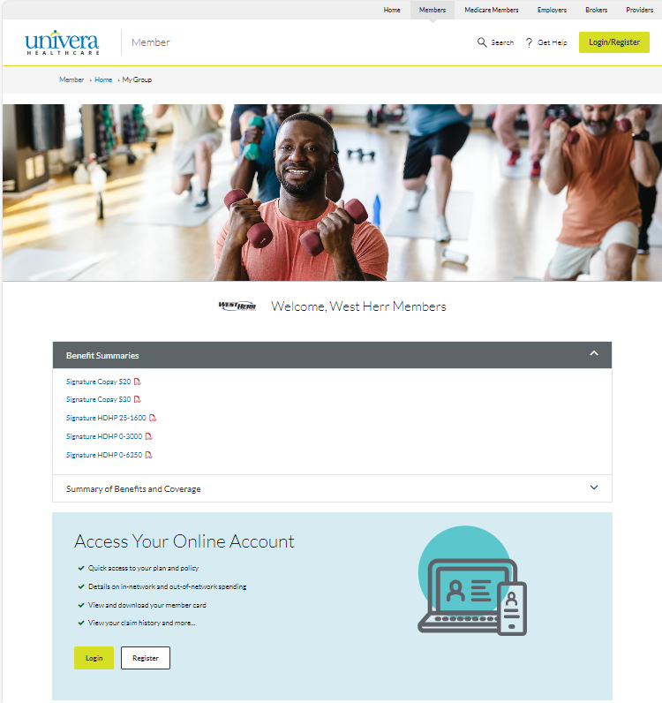

Custom Landing Page
Right Here for Labor-Management Healthcare Fund ​​​
Tailored and Customizable to LMHF’s Needs​
Open Enrollment Materials​
Benefit Profiles​
Wellness Programs​
Onboarding care support
Direct access to Care Management
Welcome, LMHF Members!
Core POS 203
Enhanced POS 202
LMHF Bronze
Value PBA POS 204
Value POS 204

Slide 9
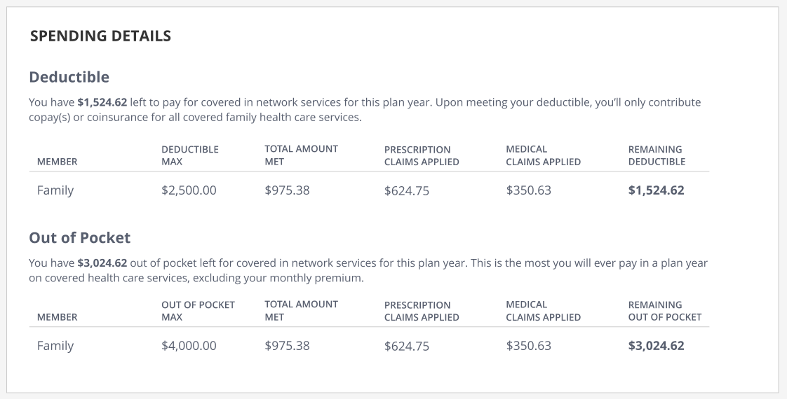
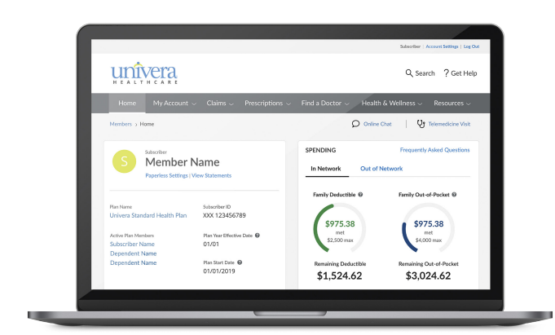
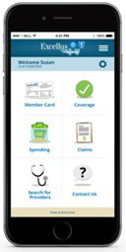
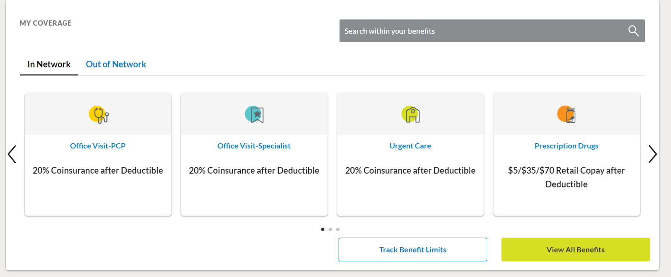
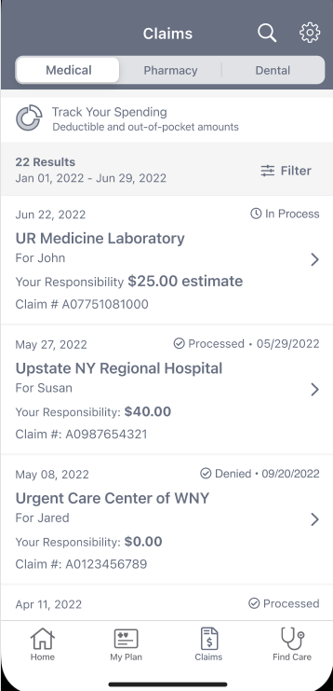
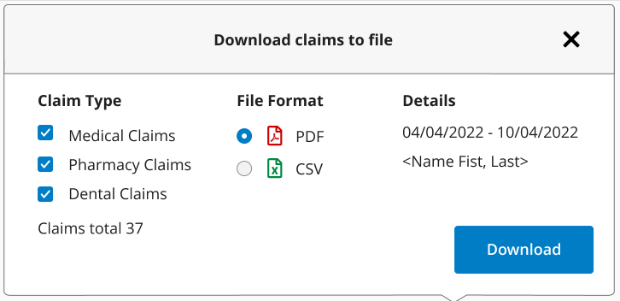
Member View of Portal
Right Here for Labor-Management Healthcare Fund
Digital Tools for Managing Health Care
View Benefits & Coverage
View Out-of-Pocket Expenses
Search Medical Claims
View Integrated Member ID Card
Health & Wellness Programs
View Statements and Documents
Find a Doctor
Setup a Telemedicine Visit
Estimate Medical Costs
Search Authorizations
Access Partner Apps
Access expert information on 6,000+ health topics
Understand what services and average costs to expect during a treatment of care

Slide 10

Seamless
Implementation

Slide 11






The LMHF Dedicated Concierge Service Model
Right Here for Labor-Management Healthcare Fund
Onboarding Phase 1
Our Goal is to Ensure Continuity of Care
Dedicated and Highly-Trained Customer Service Team specialized in LMHF, including the plan design and wellness program offerings.
ACCOUNT
MANAGEMENT
Integrated Care Managers will help to provide seamless transition of care.
LMHF
ANALYZE &
RECOMMEND
MEMBER
ENGAGEMENT
Care Coordination directly with providers – placing members in the center of their care.
Making You and Your Members’ Life Easier – Innovative tools to guide you and your members.
REPORTING

Slide 12

Proven Partners Through Change
Right Here for Labor-Management Healthcare Fund
Over the past 2 years,
we have successfully transitioned:
27 Groups
An ongoing collaborative strategy to maximize health, value and outcomes for members while driving the best financial outcomes.
Our Commitment to You:
Dedicated customer service line
Benefit plan match
Customized training and testing
LMHF custom web page
Market leading data/analytics
Dedicated cross functional team to support success
10,000 Members
20 Groups from Highmark
6,300 Members
7 Labor Unions
6,100
Union Members
Notes:
How many from Highmark. 26% of new groups have been labor unions.

Slide 13


















IMPLEMENTATION TIMELINE
Right Here for Labor-Management Healthcare Fund
Implementation Timeline
Key milestones to ensure successful implementation for a 1/1/2025 effective date: In partnership with LMHF, the Univera Healthcare team will focus on reviewing and discussing detailed benefit designs prior to implementation. This collaborative effort ensures accuracy of benefit design, benefit interpretation, and plan administration.
June
August
October
December
Confirm Benefits
& Agreements
Onsite Open Enrollment Meetings
Initiate Benefit
Coding/ Testing
Mail Member Identification Cards
Coverage Begins 1/1/2025
Mail Customized LMHF Welcome Packet 9/1/2024
Group Onsite Member Meetings Begin 10/1/2024
Receive Open Enrollment Inbound Eligibility File
Post- Implementation Meetings Begin
Kick off
Recruiting of Additional Massage Therapists Begins 7/1/2024
Concierge Team Outreach to OOA Members Begins 9/1/2024
Concierge Inbound Line Opens 11/1/2024
Member Communications
Define Implementation Requirements
Confirm
Member Communications
Administrative Billing Begins 12/1/2024
Weekly Claims Billing Begins 1/1/2025
Initiate Inbound Eligibility
July
Group Support Meetings Commence 8/1/24
September
November
January
Notes:
Change one Icon

Slide 14


Right here.
For you.

Slide 15
Questions?

